Slide 1

Illinois Fire Inspectors Association (IFIA)
Emergency Action Planning
22 May 2020

Slide 2

Introduction
Jon M. Evenson—Owner, TRIPLE E SAFETY GROUP
Emergency Management Consultant
Former Director of Emergency Management
  Rolf Jensen & Associates
Former Technical Committee Member:
  NFPA 1620—Pre-Incident Planning
  NFPA 72—Fire Alarm and Signaling Code
Responsible for EAPs for various high-profile projects

Slide 3
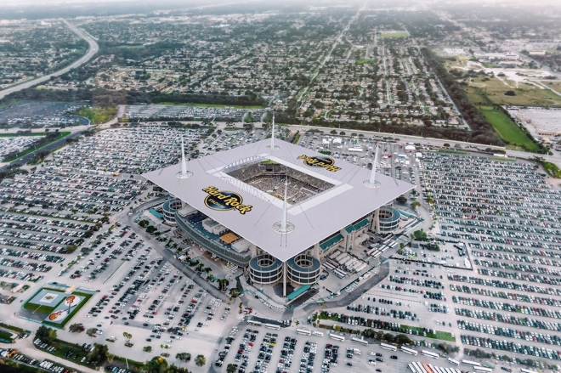



PROJECT EXPERIENCE

Slide 4

Objectives
Provide an overview of the Emergency Action Planning process to help identify how EAPs shall be developed, implemented and coordinated with First Responders.
Provide an overview of potential challenges that sites face when coordinating the initial response efforts prior to the arrival of First Responders.
Review critical elements of emergency action planning to support effective response efforts to emergencies.

Slide 5

Key Questions
How do sites develop effective Emergency Action Plans to support the identification, reporting and coordination of initial response efforts?
How can sites coordinate with First Responders upon arrival to their site during an emergency?
How does COVID-19 affect how site prepares for and coordinate response efforts at their sites?

Slide 6
What Will We Cover…
Emergency Action Planning (EAP)
EAP Challenges
Case Studies
Question and Answer

Slide 7
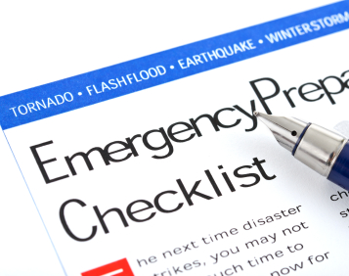
Emergency Action Planning

Slide 8
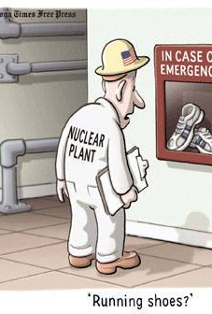
Emergency Action Plans (EAP)
EAPs are critical to the identification, communication and management of response efforts.
Shall be designed to coordinate initial response efforts UNTIL arrival First Responders.
Shall be developed and vetted to confirm that the protocols and activities are developed, reviewed and approved by a core team of stakeholders.

Slide 9
Emergency Action Plans (EAP)
EAPs shall be reviewed by all levels of management to verify their information and involvement in the EAP.
EAPs shall be reviewed by Legal to review any potential legal issues that may arise due to the EAP protocols.
EAPs shall be designed specifically for the site and/or operations. Without specifics related to the site and/or operations, the EAP will not yield the desired results.

Slide 10
Emergency Action Plans (EAP)
EAPs shall be developed by site/building representatives and presented for review by the local First Responders.
First Responders shall be asked to be involved during the development and shall provide a higher level of coordination in the event of an emergency.
EAPs shall be designed as an All-Hazards Plan approach. The number and nature shall be defined as part of an assessment early in the process.

Slide 11
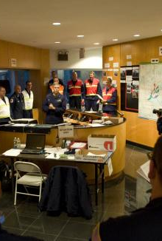
Review of Unified Command (UC)
Unified Command comprehension is a vital element of an EAP and shall outline how the site/building shall coordinate with multiple First Responders that may arrive on-site to support efforts.
Unified Command shall identify central, pre-determined representatives from the site/building that shall act as a liaison between the First Responders and the site.

Slide 12
Review of Unified Command (UC)
Enables all responsible agencies to manage an incident together by establishing a common set of incident objectives and strategies.
Allows Incident Commanders to make joint decisions by establishing a single command structure.
Maintains unity of command. Each employee only reports to one supervisor.

Slide 13
Review of Unified Command (UC)
Span of Control shall be reviewed and integrated into the EAPs to identify how control shall be maintained over an extended period.
Span of control considerations are influenced by the:
  Type of incident.
  Nature of the task.
  Hazards and safety factors.
  Distances between personnel and resources.

Slide 14

Initial Response Efforts
Upon Report of an Emergency…
  Quick and Accurate Reporting
  Confirmation of Threat/Emergency.
  Review Information.
  Notify First Responders.
  Coordinate Initial Response Steps.

Slide 15

Initial Response Efforts
Upon Arrival of First Responders…
  Plan for arrival of First Responders.
  Secure Access to Site.
  Provide Status Briefing.
  Make Critical Staff Available.
  Transfer Command.

Slide 16

Communications with First Responders
For Site Management Teams…
  Identify Primary Responder.
  Coordinate secondary notifications.
  Accurate Information to Dispatch.
  Identify Site Access Issues.
  Remain in Communication.

Slide 17
Communications with First Responders
When Notified, First Responders…
  Will respond with needed support.
  Don’t want your opinions.
  Will assume command.
  Will direct all activities.

Slide 18

Transfer of Command
When Transferring of Command…
  Provide a briefing on the status of response efforts.
  Provide information critical to the building/operations.
  Provide any occupant information that may be needed.
  Provide a single point of contact.
Transfer of Command requires quick and accurate information to allow the First Responders the ability to quickly understand the situation and potential issues/concerns they need to address.

Slide 19

Coordination and Support of UC
The UC shall be controlled by the First Responders and the site shall support them.
The UC shall determine what actions need to be taken by whom, when and why.
The UC shall be responsible for the overall response a and the site is responsible for providing the needed support requested to coordinate response efforts.
Without support from the site, the UC may face challenges in coordinating response efforts.

Slide 20
Coordination and Support of UC
The UC may request a specific location to establish their Incident Command Post.
Site management shall coordinate UC requests for Incident Command Post support based on the nature and severity of the emergency.
Site management shall provide the UC with access to critical security and life safety information and systems to support response efforts.

Slide 21
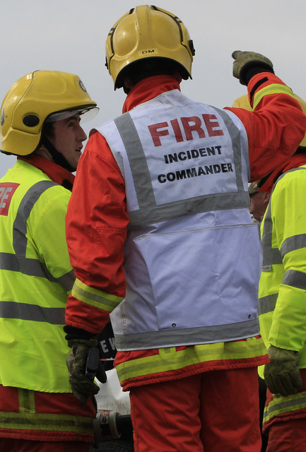
All Clear/Resumption of Operations
All Clears defined when the EAP can be deactivated and the Business Continuity Plan can be activated.
All Clears shall be coordinated by the Incident Commander.
All Clears shall be communicated to the Liaison Officer and then to the site/building occupants.
EAP shall remain active until the All Clear is provided and confirmed.

Slide 22
All Clear/Resumption of Operations
Resumption of Operations can only be started when the First Responders, Site Management and other key stakeholders agree that the site is safe to resume operations.
The EAP shall review potential issues/concerns related to delayed resumption of operations.
The EAP shall coordinate with the BCP to identify potential alternate working arrangements as needed.

Slide 23

Response
Challenges

Slide 24
Response Challenges
Before, during and after an emergency, various challenges could have an adverse affect on response efforts.
During the EAP development, challenges shall be identified and attempted to be addressed in the EAP protocols.
During meetings with First Responders, face-to-face meetings help build relationships, familiarize responders to the site and allows for the process of putting a face to a name.

Slide 25

Challenges: Communications
Challenges with different systems and equipment.
Challenges with different languages.
How do we communicate with hearing/visually-impaired.
What information is shared with whom.
Who determines what information to provide.
What mechanism are used for communications.

Slide 26
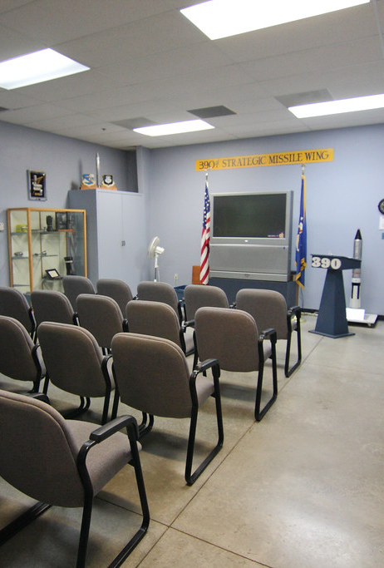
Challenges:
Directions and Briefings
Where are briefings held and timing.
Who leads the briefings and directions.
What information is shared during briefings.
How are media outlets managed during briefings.
How are response directions coordinated with sites.

Slide 27

Challenges:
Transfer of Command
Who coordinates the transfer of command.
What is needed to transfer command.
Who determines when to transfer command.
Where is transfer of command conducted.
After the transfer, how are activities coordinated.

Slide 28

Challenges: Management of Response Efforts
What step have been taken prior to arrival.
Why have specific steps been taken.
How are response efforts managed throughout site.
How are response efforts communicated.
Who is providing directions to staff and management.

Slide 29

Challenges: Coordination of Affected Occupants
What information is provided to occupants.
How do we coordinate special assistance occupants.
How do we account for various types of occupants.
Where will we direct occupants to upon exiting.
How do we coordinate post-emergency activities.

Slide 30

Challenges:
Information Flow
Coordinate information flow as the event unfolds.
Multiple points of information based on emergency.
Points of contact for various stakeholders.
Identify primary method of communication.
Accuracy checking information being distributed.

Slide 31

Challenges: Social Media and Public Relations
Social Media has added an extra element of stress before, during and after an emergency.
Social Media can misrepresent information concerning the emergency and/or response efforts.
Social Media protocols shall be developed to minimize the potential negative impacts of social media on response efforts and brand reputation.

Slide 32

Challenges: Social Media and Public Relations
Social Media is not only critical to control mis-information, but is critical to communicating with our staff, vendors, clients, etc.
Proactive social media statements can reduce the negative impact on the organization.
Management of social media aspects shall be developed as part of the EAP.

Slide 33

Challenges: Social Media and Public Relations
Public Relations needs to be developed prior to an emergency to help “get ahead” of stories and mis-information.
Standard templates should be developed with authorization protocols designed to streamline the development and dissemination process.
Holding statements and executive communication training shall be defined as part of the overall EAP.

Slide 34
Challenges: Social Media and Public Relations
Emergency planning needs to prepare to make public statements that are accurate and don’t include any non-factual information.
Executives and spokespersons need to understand potential questions or information that may be brought up.
Single Voice Policy is critical.

Slide 35
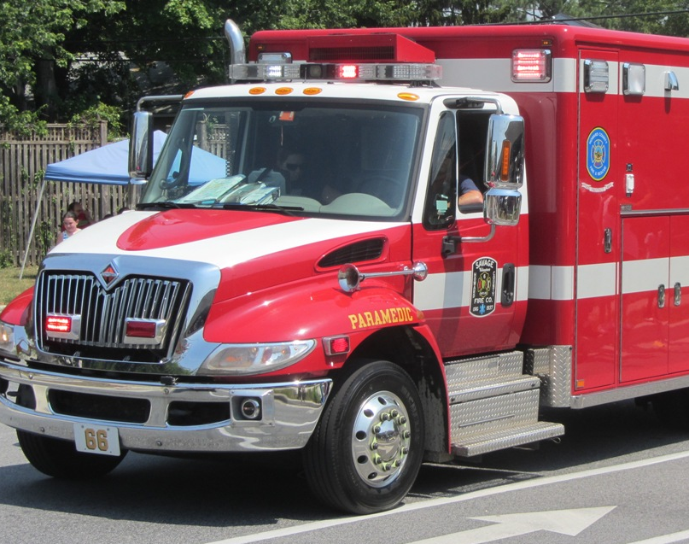
Case
Studies

Slide 36

Address Downtown Dubai
New Year’s Eve 2016
1 Million People in Area
Up to 3,000 inside Hotel
No Deaths, Some Injuries
Poor Cladding/Chimney
LUCK was factor

Slide 37
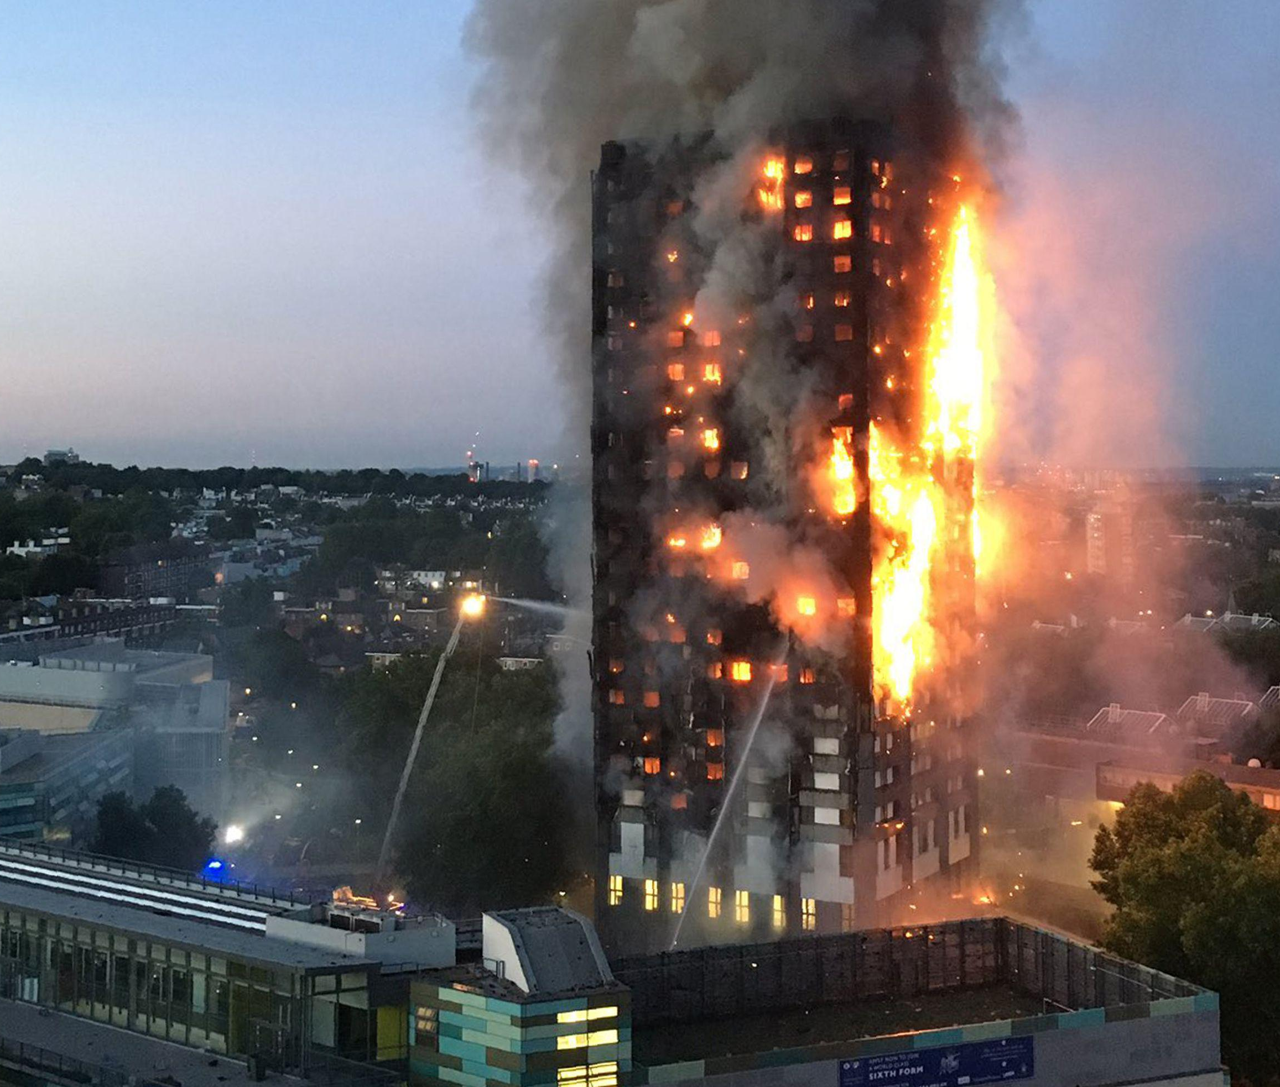
Grenfell Tower
Deadliest structural fire in UK since ‘88
Over 70+ deaths and 70+ injuries
Building Cladding was a critical issue
Critical Error—Evacuation Directions
Still under investigation

Slide 38

Lessons Learned
Emergencies are defined by the initial response efforts taken prior to the arrival of the First Responders.
Communications and coordination with occupants is vital to the success of response efforts.
LUCK is always a great equalizer when it comes to emergency response efforts.

Slide 39

COVID-19 Response
COVID-19 has required us to review how we coordinate response efforts and evacuations.
Do sites have to incorporate social distancing into evacuation planning?
How will First Responders coordinate with building that have minimal staffing levels?
How will First Responders access critical information and systems upon arrival?

Slide 40
COVID-19 Response
As buildings return to operations, staffing and management levels may be affected and reduce the number of people to support response efforts.
Without current and updated plans, First Responders may have issues with entering and coordinating response efforts at a building.
Without key team members present, First Responders may be faced with larger issues upon arrival to the site.

Slide 41

Use of EAP Technology
The use of emergency management software, apps and other programs may provide sites and First Responders with the ability to coordinate response efforts easier.
The use of technology shall be reviewed to allow for better coordination of communications and response coordination.
The use of technology also provides the ability to coordinate documentation and after-action support.

Slide 42



Use of EAP Technology

Slide 43

In the End…
Proper emergency action planning can reduce the potential negative impacts on a building occupants and operations.
With coordination with First Responders, buildings can elevate their ability to respond to potential emergencies.
Planning requires a continual review, improvement and communication process to maintain a level of preparedness for all responsible for the site and operations.

Slide 44

Thank You…
Jon M. Evenson
Owner—Triple E Safety Group
Email | jon@tripleesafety.com
Phone | 815.900.1271
Web | www.tripleesafety.com

